Slide 1



Amazon Prime Analysis
View in Power BI
Last data refresh:
02/05/2025 13:59:56 UTC
Downloaded at:
02/05/2025 14:02:56 UTC

Slide 2
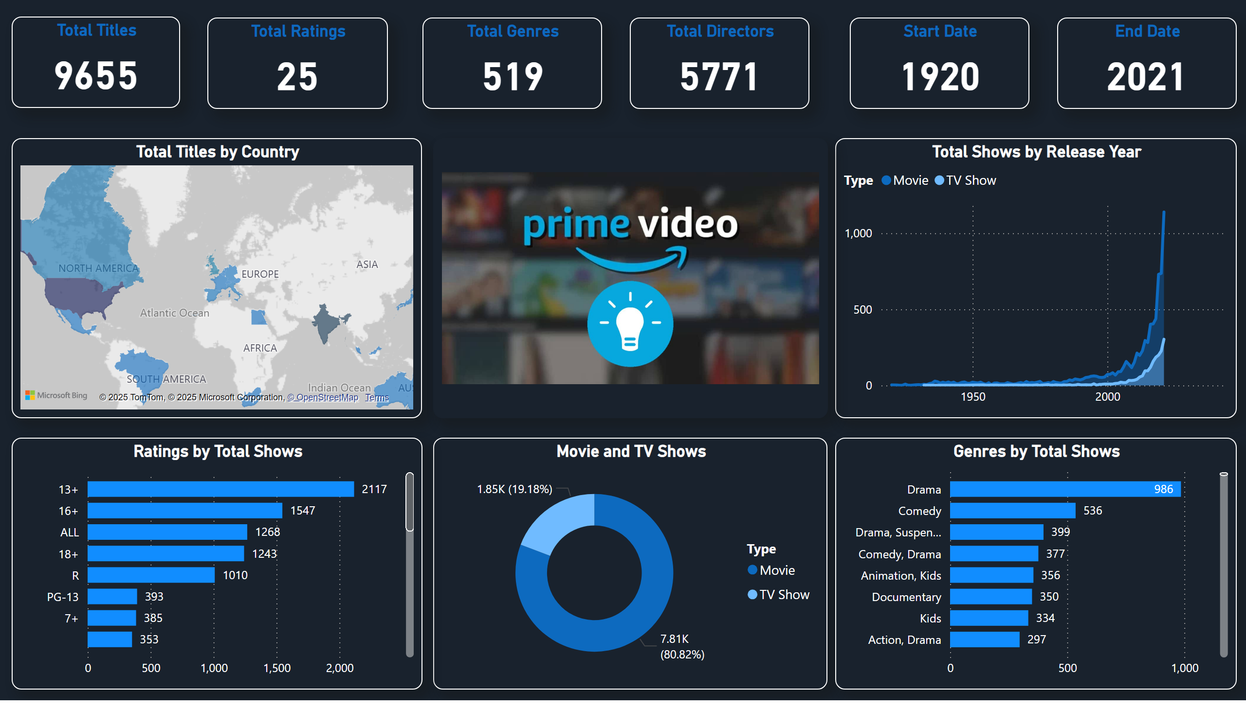
Page 1
Notes:
Total Titles
No alt text provided
Total Ratings
No alt text provided
Total Titles by Country
No alt text provided
Movie and TV Shows
No alt text provided
Total Shows by Release Year
No alt text provided
Ratings by Total Shows
No alt text provided
Genres by Total Shows
No alt text provided
Total Genres
No alt text provided
Total Directors
No alt text provided
Start Date
No alt text provided
End Date
No alt text provided
image
No alt text provided

